Slide 1

How Black Radio is using its Voice to Educate the Black Community about the Attack on its Health and Black Doctor’s Civil Rights
African American Civil Rights Caucus for the Radio Preservation Society by Angela Greene
Notes:
.

Slide 2
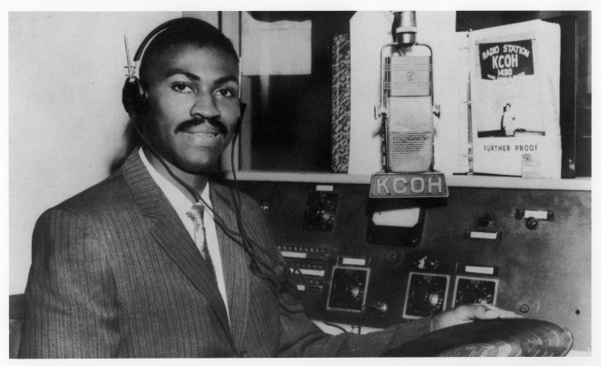
What is Black radio’s responsibility to Black doctor’s and the Black community?
Notes:
Black radio has long had an unspoken, expected duty to its community. It was a main source of entertainment and a primary source of information for us and about us in the Black community. Before Black radio, the Black community received its messages by word of mouth because radio stations were owned by white people. When Blacks evolved into radio station owners, they shared information with our community, which in many cases was the only places they would hear about it.

Slide 3
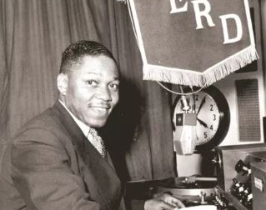
Jesse Blayton’s WERD-AM
The programming focused on the African American audience, which he called “Negro Appeal” music, which was original R&B music that was not being featured on other radio stations.
In 1949 WERD was the only black-owned radio station. Blayton later hired 4 Black male announcers including Jack Gibson, The Godfather of Black radio who frequently highlighted news for and about the Black community including the civil rights movement.
Notes:
Jesse Blayton purchase WERD, a 1,000 watt radio for $50,000 . He sold WERD in 1968, when he retired on 1968. He died in 1977.

Slide 4

Atlanta’s, Voice of the Community
Notes:
Atlanta’s oldest Black station and staple in the Black community has taken the lead on educating the Black community on how its health is connected to the criminalization of Black and Brown doctors. A problem that has remained most obscure to the masses until now

Slide 5
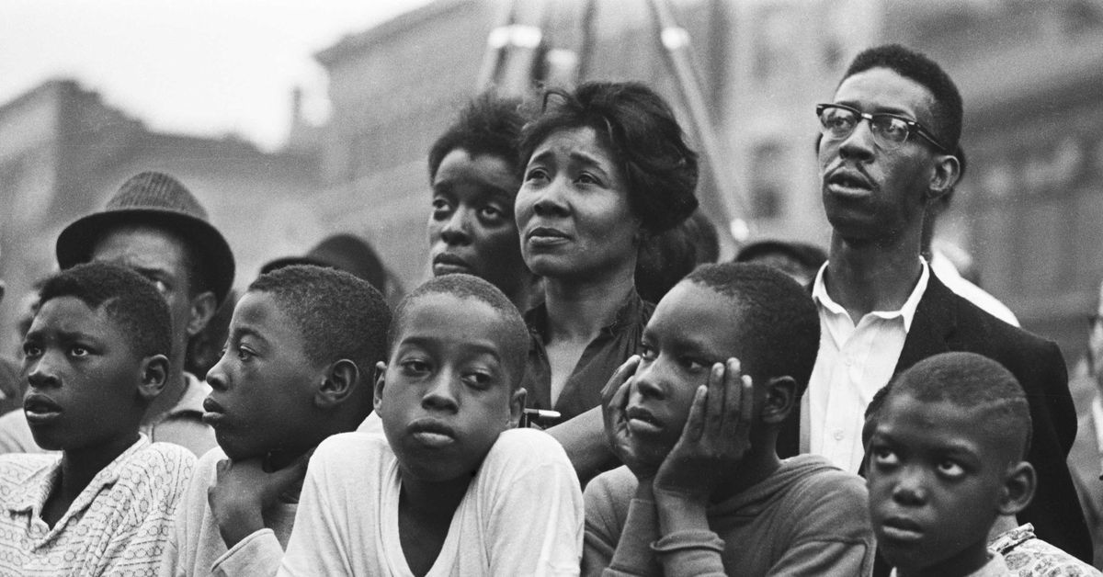
How does the attack on Black doctors affect the health of the Black community?
Notes:
The governments orchestrated attacks the Black and Brown doctors directly affects the health of the Black community because it eliminates our choice to have a doctor who looks like you, understands you, speaks like you and someone who can address the nuances of the Black culture. Cultural sensitivity is important to Blacks as patients and to Doctors as caregivers. Some people just feel more comfortable talking to a doctor who likes them because of the blatant mistrust of white doctors because the history of abuse towards Black the community.

Slide 6
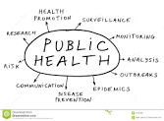
Experts Warn of Public Health Crisis
The sparse number of Black doctors, only 5.7% combined with high number of Black and Brown doctors who are being imprisoned is creating a public health crisis.
According to the Association of American Medical College, this statistic does not reflect the communities they serve.
An estimated 12% of the U.S. population is Black or African American.
Notes:
According to researchers, when Black patients see Black doctors service to patients and patient trust are both among the cornerstones critical to the status of public health.

Slide 7
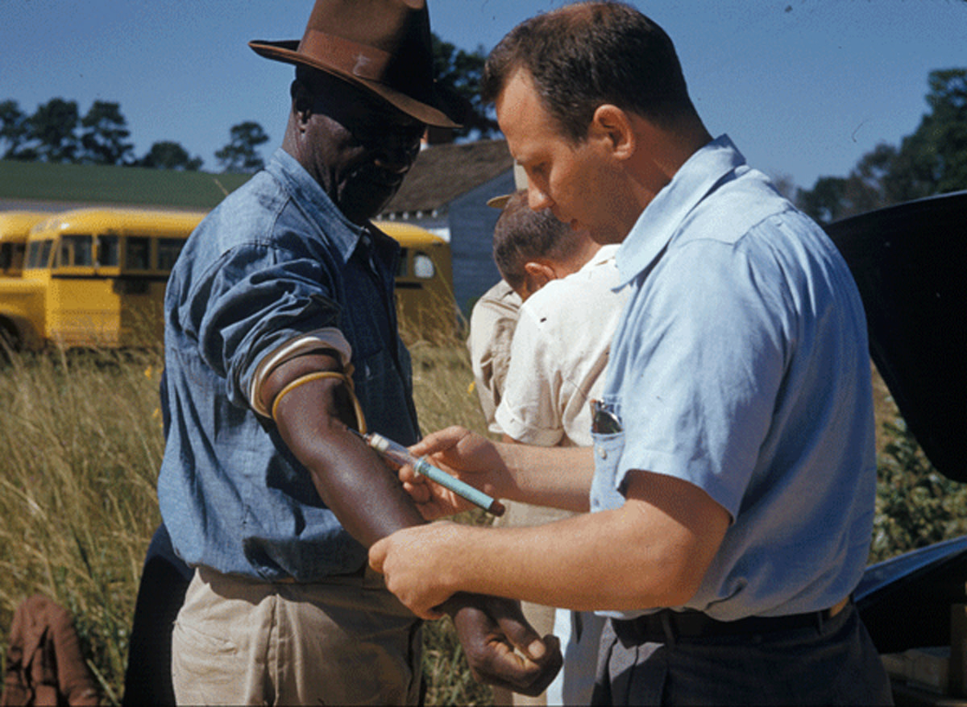
Tuskegee Experiment
Events such as the Tuskegee Experiment, in which white doctors with the U.S. Public Health Service and Tuskegee Institute let Syphilis grow inside of Black men without treating them. The experiment has a caused a permanent mistrust in the Black community.
This mistrust resurfaced during the pandemic when many Blacks were and some still remain mistrustful of the COVID-19 vaccine. As a result, many lives were lost because many people refused to get vaccinated for a lack of trust in the vaccine’s ingredients and possible long-term effects.
Notes:
WAOK Executive producer, Angela Greene recalls frequent discussions on the show she produces, On Point with Juandolyn Stokes in which countless listeners would call in to protest the COVID-19 vaccination and its requirements by many businesses, workplaces, and social events, which made it mandatory. Many callers would cite the Tuskegee Experiment and the Henrietta Lacks case as reasons why they did not trust the vaccine or the government for making them get it to be considered a healthy member of society.

Slide 8
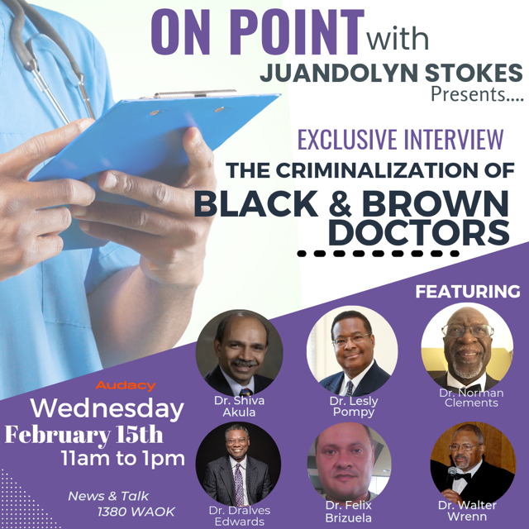
Atlanta’s oldest black station, WAOK aired doctor’s concerns about their attacks by the U.S. government in two panel discussions. This is the flyer from the first panel discussion.
Notes:
In Feb. 2023, WAOK held the first panel discussion of its kinds with our listeners, who were intrigued by what doctors reported. Each doctor was allowed to share his story, which were painful and disheartening because in most cases doctors medical careers were destroyed by the governments accusations.

Slide 9
How are Black radio, the Black Community, and Black Doctor’s Connected?
This connection lies in the fact in 2023, WAOK Atlanta has been at the forefront of educating the Black community about existence of medical racism.

Slide 10












WAOK Aired the Stories of Black Doctor’s
According to Dr. Norman Clement a dentist and pharmacist, and author and publisher of the blog, Youarewithinthenorms.com was targeted by the government. His action was the catalyst for bringing the doctors storys to our attention, this story about Black doctors was ignored by other media and some civil rights organizations.
Notes:
Dr. Norman Clement, the writer and publisher of the blog, “You Are Within the Norms” said he approached multiple media outlets with the stories of Black and Brown doctors who are being sent to prison in record numbers by the government. The logos represent media outlets who refused to cover this story.

Slide 11
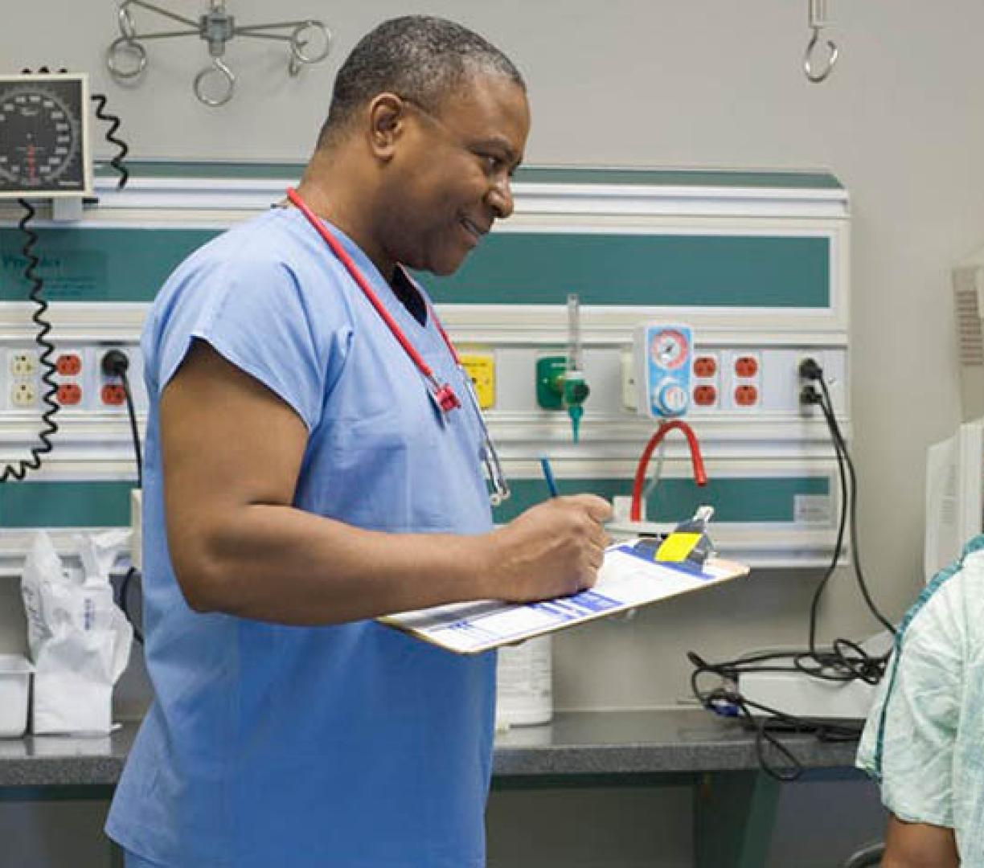
Black patients, Black physicians
Research indicates one way the trust can be rebuilt is by having Black doctors treat Black patients.
Notes:
The governments manufactured attacks on Black doctors as drug dealers or fraudsters due to what mostly amounts to clerical errors in Medicare billing is diminishing our ability to find or keep a Black doctor because we already have so few, and those few are being sent to prison at astronomical rates.

Slide 12

Data numbers
Here is the breakdown of doctors who are attacked by states.

Slide 14
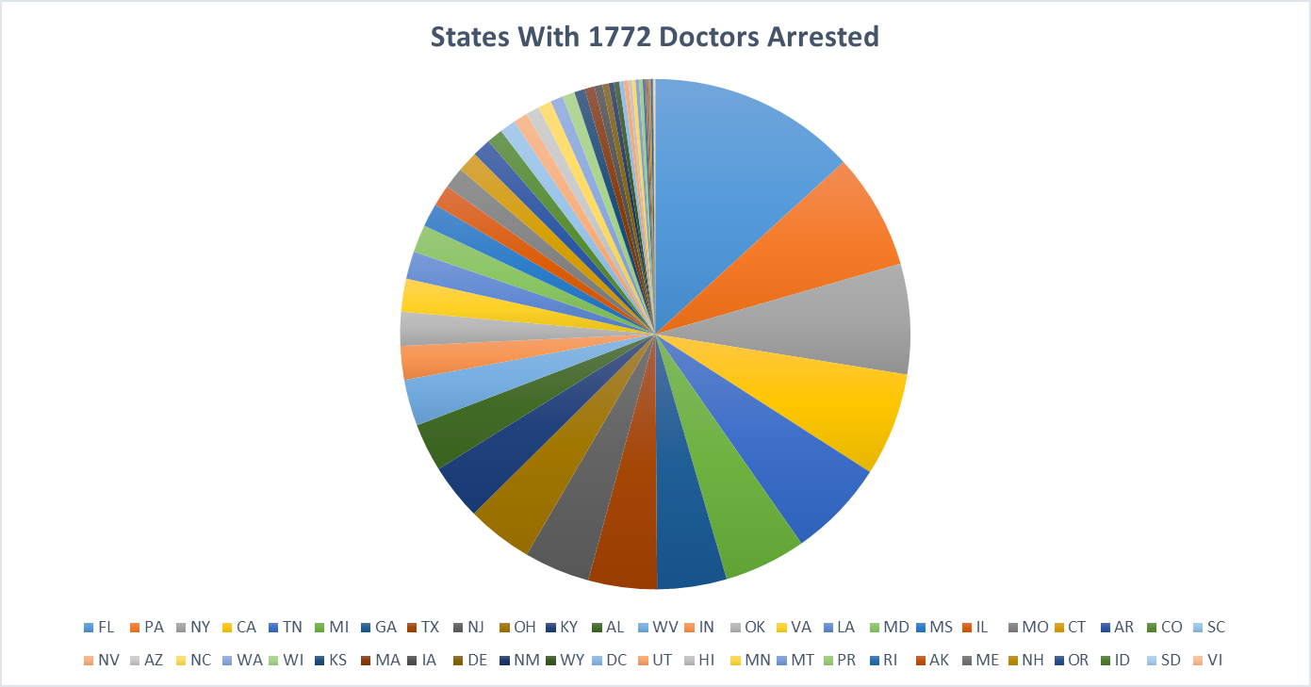

Slide 15

How are Black doctors being attacked?
Notes:
Despite the Supreme Court ruling in Dent v. West Virginia 129 U.S. 114 (1889) which says “comparatively few can judge of the qualifications of a [physician’s] learning and skill,” the public must rely on “the assurance given by his, issued by an authority competent to judge in that respect, that he possesses the requisite qualifications.” __ Black and Browns doctors have been convicted and sent to federal prison for practicing medicine. Yet efforts to undermine the authority of medical licensing boards by the government continue.

Slide 16
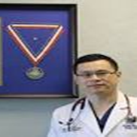
The Ruan Rule
The Ruan Rule comes from the case of Dr. Xiulu Ruan in which he was convicted of prescribing opioids in a “pill mill” case without proper justification, which is a violation of federal law although he was a practicing physician at the time.
The 11th Circuit Court held that once a doctor who is charged with dispensing controlled substances produces evidence that his conduct was “authorized,” the Government must prove beyond a reasonable doubt that the doctor knowingly or intentionally acted in an unauthorized manner.
Several doctors who have been interviewed for this presentation rest their cases on this rule, which should vindicate them, but most cases it does not.
Notes:
The Supreme Court ruled unanimously in favor of Drs. Ruan and Shakeel Kahn who were both convicted in this case. This case and similar cases shine a light on the juxtaposition of doctor’s ability to prescribe necessary pain medicines against the looming opioid crisis, which seeks to criminalize doctors who prescribe these medicines without medical justification that meets their standards of care. Why are some doctors exonerated and others not, asks Dr. Walter Wrenn

Slide 17
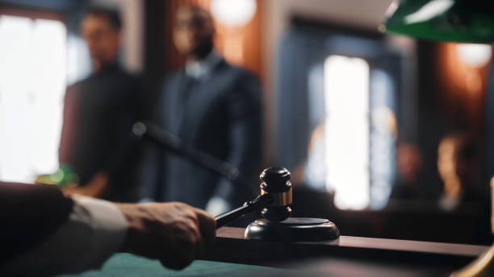
Dr. Walter Wrenn, Internal Medicine and WAOK Panelist
In Oct. 2021 Dr. Wrenn entered a plea agreement because he believed he had no other choice. He was facing 21 years in jail, a $45,000 fine, 5-years probation, and an agreement not practice medicine anymore.
Dr. Wrenn was innocent but was coerced into signing a plea agreement.
But in a twist of fate, on June 27,2022 the U.S. Supreme Court said in a 9-0 ruling:
“A physician could not be charged with a crime for prescribing a medication they were authorized to prescribe.”
Notes:
After this Supreme Court and the 11th Circuit Court ruling: Why are some doctor’s convicted and even fewer exonerated? Dr. Wrenn is one the few doctors who was exonerated based on these rulings. He said in a letter to Angela Greene [this ruling]: “It reestablished the doctor patient relationship and the authority of the treating physician. Based on that ruling no crime had been committed. At the time I saw my patient ,I had a valid medical and DEA license. My malpractice insurance was paid. I was authorized to prescribe the medication. The medication was FDA approved.”

Slide 18
What are Black and Brown Doctors Accused of in most Cases?
Drug Charges, like those levied against Dr. Ruan are common for doctors who treat extreme pain and their patients are called “drug-seeking.”
These doctors have been erroneously linked to the opioid crisis.
The result is bureaucrats determing how and what to treat for pain.
Medicare Fraud is what many other doctors are criminally charged with for billing code errors.
Doctors accused of Medicare Fraud are accused of stealing of millions of dollars from the government without proof or evidence.
Notes:
In both cases, doctor’s offices were raided and their money, property and assets are taken. Many doctors lose everything including their families over bogus charges. Once everything is taken, they are then convicted and sent to prison after they are coerced into taking a plea.

Slide 19
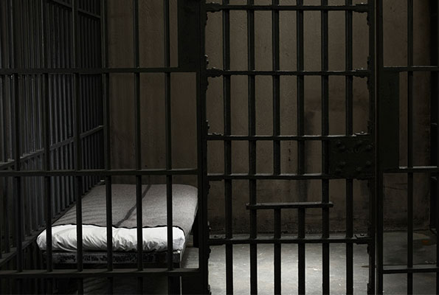
The government’s conviction rate is almost 100% because most doctors are forced to take a plea.
Notes:
Most doctor’s who are investigated, indicted, and convicted go to federal prison because in many case they are coerced into taking a plea deal for which they know they are not guilty or their attorney’s are not skilled in how to challenge the government and therefore do not have a strong enough defense for their clients to win so they put up a white flag, and the doctors go down in flames.

Slide 20

“If the forensic scientist that is working for the DEA claims that 99% of opioid poising/OD are from illegal substances, why is the DEA still raiding and prosecuting prescribers?”
“The problem isn’t with pills prescribed by your doctor and dispensed by a pharmacy-its on the illicit market.”
Steve Oulton

Slide 21
FDA has approved first over-the-counter opioid overdose antidote Narcan
Because of the record number of drug overdose deaths, the FDA has approved the first ever naloxone nasal spray and its availability, which is a priority.
“Opioid deaths are the leading cause of accidental death in the US. Most are among adults, but children are also dying largely after ingesting synthetic opioids such as fentanyl.” CNN
Notes:
In a surprising move, the Food and Drug Administration has made Narcan, a nasal spray that is used to reverse the effects of opiate overdose available over the counter. As we have learned in this presentation many doctors have lost their medical licenses and even more have gone to prison or are preparing to be sent to prison for prescribing legal opiates that they are authorized to prescribe as medical professionals. Why then is this happening?

Slide 22


Primary Targets
Algorithm’s are used to target black and brown doctors who are financially fit.
Notes:
Each of the doctors who were interviewed on WAOK, fit the profile of the doctors who are commonly targeted, for age between 50-70 plus years old, financially fit including property and assets, and work independently or not affiliated with hospitals. Once doctors are targeted their money, property , and assets are immediately seized and not returned regardless if they are officially convicted or not. Where does the money, property and assets end up?

Slide 23

Algorithms
The government uses the company, Qlarant NBI Medic as their forensic tool to collect data analytics to red flag certain physicians.
Notes:
Qlarant boast its ability to obtain speedy convictions with a conveyor belt algorithm to coordinate convictions for US Attorney’s Office to strengthen convictions thru the manipulation of data. They refer cases to the DOJ for criminal indictment.

Slide 24
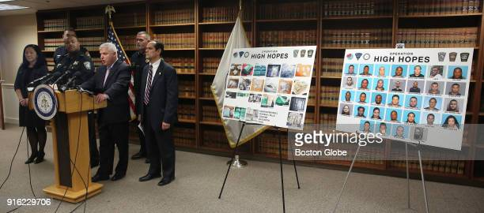
Dr. David Lewis, anesthesiologist and interventional pain specialist and WAOK panelist
In Dec. 2018, Dr. Lewis along with 5 other physicians were wrongfully indicted for conspiracy to commit health care fraud, and the illegal distribution of controlled substances. In June 2022, they were found Not Guilty on 56 counts.
Dr. Lewis said the key for overcoming charges from the government is having an attorney that specifically practices in this area, not just criminal defense.
Notes:
Dr. Lewis said evidence does show that he and colleagues were targeted based on several factors including, Black and Brown owned practice, their large percentage of Medicaid and Blue Cross patients, high-dollar earning physicians, $1 m a year and upwards, “red flagged” busy practices for schedule II narcotics with cash payments and medical equipment used for “unnecessary injections”. The governments allegations were false and baseless.

Slide 25
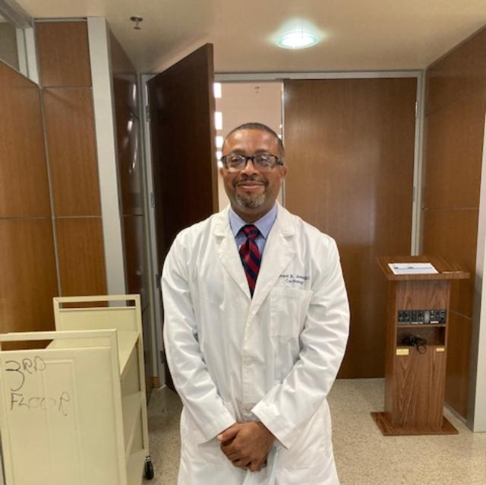
Dr. Michael Jones, Cardiologist
Dr. Jones served 16 months in federal prion for Medicaid Fraud. He was denied reinstatement twice by the Louisiana State Board of Medical Examiners without explanation.
Notes:
On Feb. 27, WAOK Producer Angela Greene attended his hearing as a member of the media. Dr. Jones was reinstated in a 7-2 vote. Dr. Jones believes his reinstatement was due in part the WAOK’s media presence.

Slide 26

Black and Brown Doctors Civil Rights are Violated When:
*They are indicted without conviction
*When the government manipulates statutes and codes that do not apply and without sufficient evidence
*Attorney’s work in tandem with the government, extorting attorney fee’s without fully representing them or representing them and prosecuting them simultaneously without their knowledge.
Notes:
According to Annette Jackson Assistant Chief of Operations for Louisiana United International (LUI), a civil, constitutional and human rights organization, especially committed to eliminating unlawful discrimination in the state of Louisiana

Slide 27
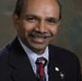
Dr. Shiva Akula, Infectious Disease
Dr. Akula has been criminally indicted for medical billing fraud, for patients he never saw.
White doctors at a competing hospital were also charged, but they were charged civilly, allowed to pay a penalty and continue to practice.
He is being assisted by LUA.
Notes:
Dr. Akula is facing criminal charges in a court with all white judges . His trial is set for May 2023. He facing 10 years in prison at 67 years-old.

Slide 28
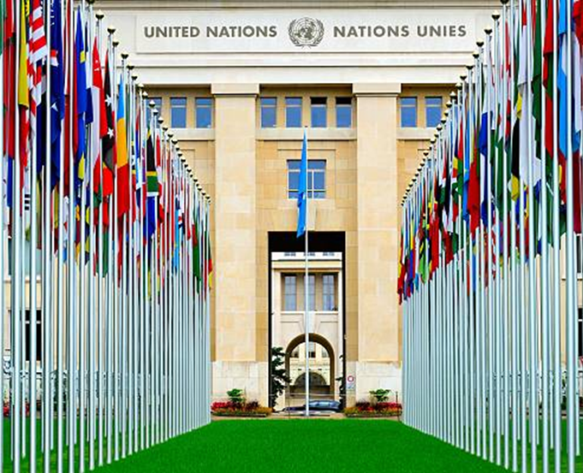
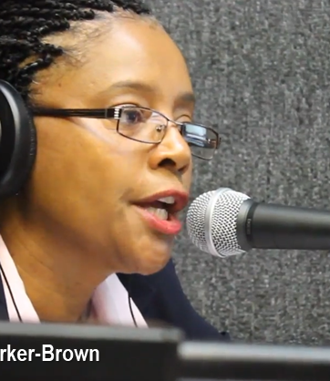
Louisiana United International
Belinda Parker-Brown, CEO of LUI in conjunction with America United International has opposed the criminalization of medicine by the U.S. government by reporting legal abuses to the United Nations Human Rights Council.
Notes:
The United Nations agreed with LUI and AUI that doctors in the U.S. were indeed being unfairly targeted and criminalized by the government.

Slide 29
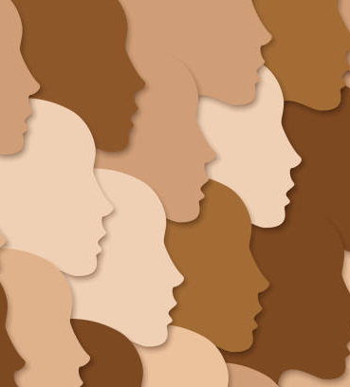
Black Radio Remains an Integral Part of the Black Community
The purpose of this presentation was to highlight the importance of Black Radio to the Black Community, the Black Community’s Health, and the Civil Rights of Black Doctor’s.
The intersection of these four elements: radio, community, health, and civil rights is the heartbeat of every Black community in America and abroad.
Black radio is the voice of the Black community. A community cannot exist without its health and the criminalization of Black and Brown doctors which violates their civil rights compounds the public health emergency of fewer and fewer Black doctors to serve its people.
Notes:
Health is Wealth! The End!

Slide 30
Works Cited
Akula, Shiva, Dr. Personal Interview. 26 Feb. 2023.
Anand, Neil, Dr. “Slide Deck of PDMP Data Analytics Research Time-
line and Statistical analysis of Opiate Crisis.” Prescription Drug
Monitoring Program Center of Excellence at Brandeis University,
Funded by federal Bureau of Justice Assistance (BJA) and by Cen-
ter for Disease Control and Food and Drug Administration
through agreement with BJA, Feb. 2010.
Baron, Richard, B. and Coleman, Carl, H. J.D. “Protecting the Legitimacy
of Medical Expertise. The New England Journal of Medicine, 18,
Feb. 2010.

Slide 31
Works Cited
De Vogue, Ariane and Duster, Chandelis. “Supreme Court sides with
doctors challenging their convictions in opioids “pill mill” case,
CNN Politics, 27, June 2022.
Howard, Jacqueline. “Only 5.7% of US doctors are Black, and experts
warn the shortage harms public health. CNN Health, 21, Feb.
2023.
Lawhern, Richard. “We Need Laws to Protect People in Pain.”
Patients suffer Under CDC Opioid Guidelines, 14 Feb. 2023.

Slide 32
Works Cited
Jones, Michael, Dr. “ 3rd Re-instatement Hearing”, Louisiana State Board of
Medical Examiners, 27 Feb. 2027.
Singer, Jeffrey A. and Bloom, Josh. “Bureaucrats are telling doctor
how to treat pain. And patients suffer needlessly.” USA Today,
16, Feb. 2023.
Oulton, Scott. “Scott Oulton, deputy assistant administrator of the
DEA’s Office of Forensic Sciences: The Problem Isn’t with pills pre-
scribed by your doctor and dispensed by a pharmacy-it’s the pills
on the illicit market,” CNN.com, 02 Feb. 2023.
*Special thank you to: Dr. Neil Anand

